Slide 1
Limitations of Discrete Diffusion Models (dLLMs)
December 2025

Slide 2
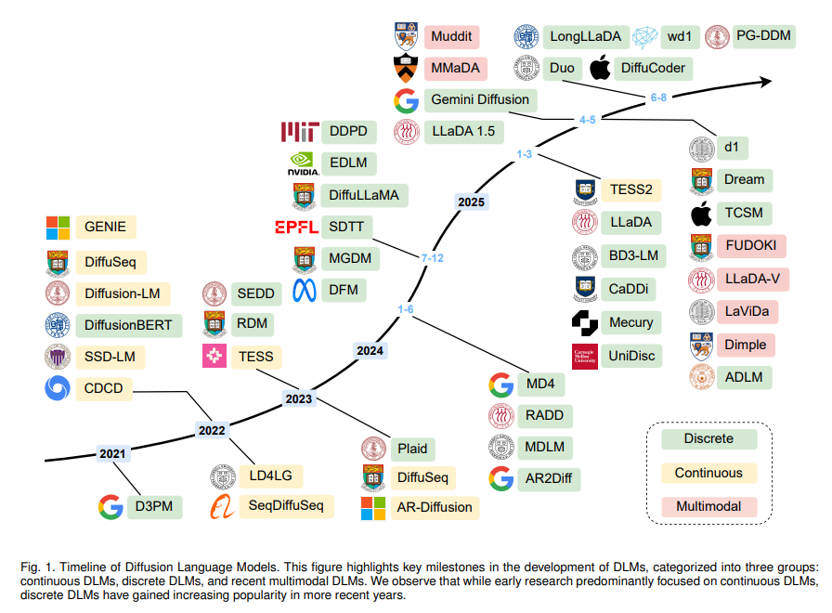
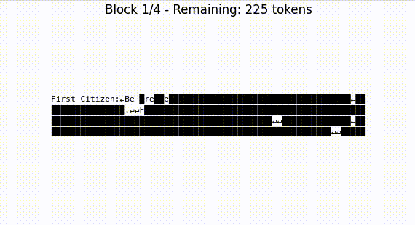
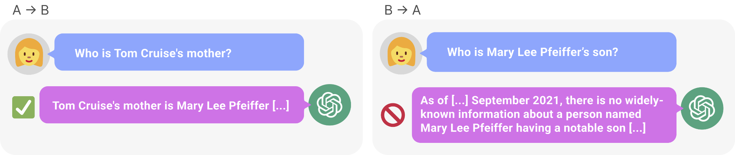
dLLMs are all the rage
They’re weird
They’re fun
They (seem to) scale OK
They’re better than ARMs in some tasks
E.g. reversal curse, sudoku
They’re fast!

Slide 3
dLLMs are all the rage
They’re weird
They’re fun
They (seem to) scale OK
They’re better than ARMs in some tasks
E.g. reversal curse, sudoku
They’re fast!

Slide 4
dLLMs are all the rage
They’re weird
They’re fun
They (seem to) scale OK
They’re better than ARMs in some tasks
E.g. reversal curse, sudoku
They’re fast!

Slide 5
dLLMs are all the rage
They’re weird
They’re fun
They (seem to) scale OK
They’re better than ARMs in some tasks
E.g. reversal curse, sudoku
They’re fast!

Slide 6
dLLMs are all the rage
They’re weird
They’re fun
They (seem to) scale OK
They’re better than ARMs in some tasks
E.g. reversal curse, sudoku
They’re fast!

Slide 7
dLLMs are all the rage
They’re weird
They’re fun
They (seem to) scale OK
They’re better than ARMs in some tasks
E.g. reversal curse, sudoku
They’re fast!

Slide 8

They’re fast in large part because of parallel decoding
(i.e. because they can sample multiple tokens at a time)
(It’s also pretty common now to do blockwise semi-autoregressive sampling)
Allows for KV-caching
But some recent papers/blogs have questioned the limitations of parallel decoding and dllms in general

Slide 9

They’re fast in large part because of parallel decoding
(i.e. because they can sample multiple tokens at a time)
(It’s also pretty common now to do blockwise semi-autoregressive sampling)
Allows for KV-caching
But some recent papers/blogs have questioned the limitations of parallel decoding and dllms in general

Slide 10
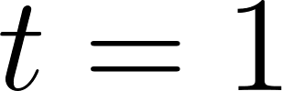
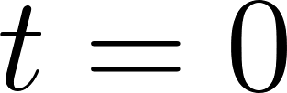
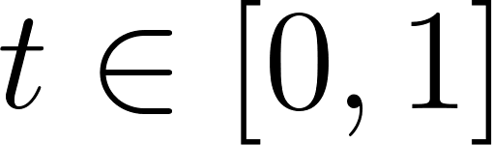
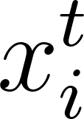
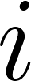
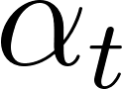
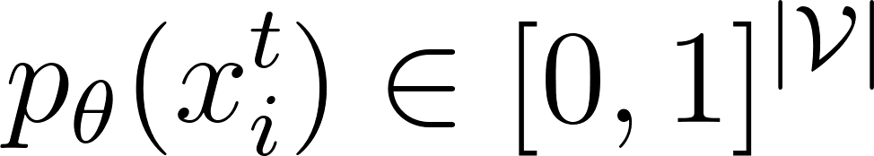
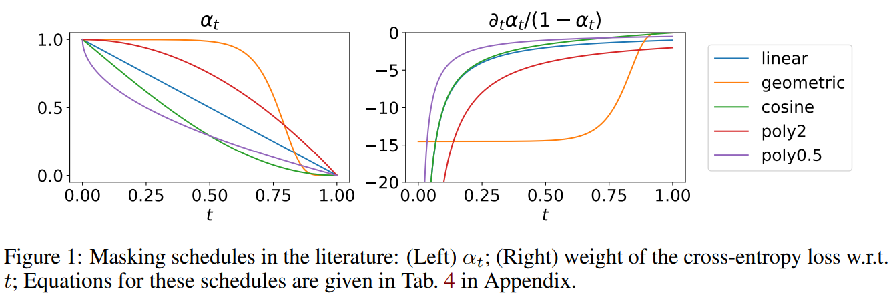
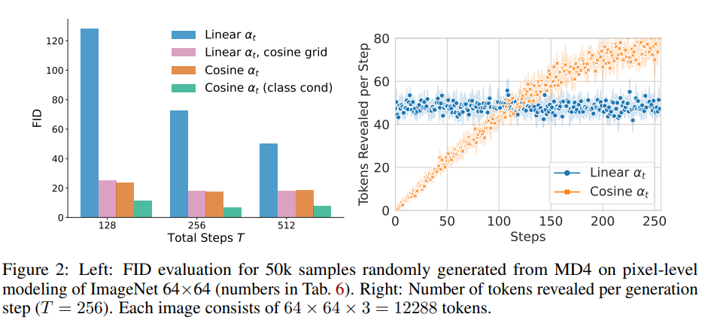
Recap: Sampling from a dLLM
Go from all-noise ([MASK]...[MASK]) at to noiseless at .
At time we will unmask token at index with probability .
For this token, we sample the new non-[MASK] token value using mask-prediction probabilities .
Many options are available for the schedule .

Slide 11
Recap: Sampling from a dLLM
Go from all-noise ([MASK]...[MASK]) at to noiseless at .
At time we will unmask token at index with probability .
For this token, we sample the new non-[MASK] token value using mask-prediction probabilities .
Many options are available for the schedule .

Slide 12
Recap: Sampling from a dLLM
Go from all-noise ([MASK]...[MASK]) at to noiseless at .
At time we will unmask token at index with probability .
For this token, we sample the new non-[MASK] token value using mask-prediction probabilities .
Many options are available for the schedule .

Slide 13
Recap: Sampling from a dLLM
Go from all-noise ([MASK]...[MASK]) at to noiseless at .
At time we will unmask token at index with probability .
For this token, we sample the new non-[MASK] token value using mask-prediction probabilities .
Many options are available for the schedule .

Slide 14
Recap: Sampling from a dLLM
Go from all-noise ([MASK]...[MASK]) at to noiseless at .
At time we will unmask token at index with probability .
For this token, we sample the new non-[MASK] token value using mask-prediction probabilities .
Many options are available for the schedule .

Slide 15
Recap: Sampling from a dLLM
By default this is IID per token, but we can do cleverer stuff too
Go from all-noise ([MASK]...[MASK]) at to noiseless at .
At time we will unmask token at index with probability .
For this token, we sample the new non-[MASK] token value using mask-prediction probabilities .
Many options are available for the schedule .

Slide 16
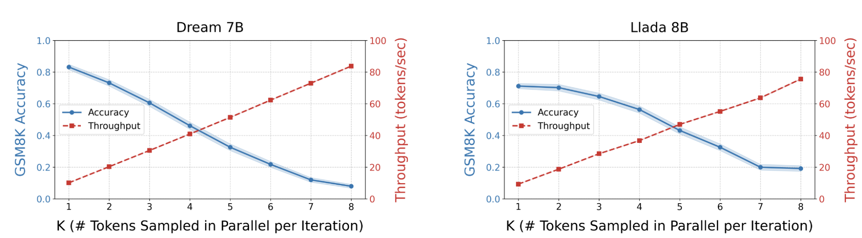
But parallel decoding isn’t always ideal…

Slide 17
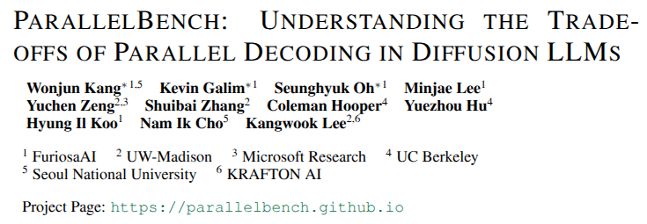
But parallel decoding isn’t always ideal…

Slide 18
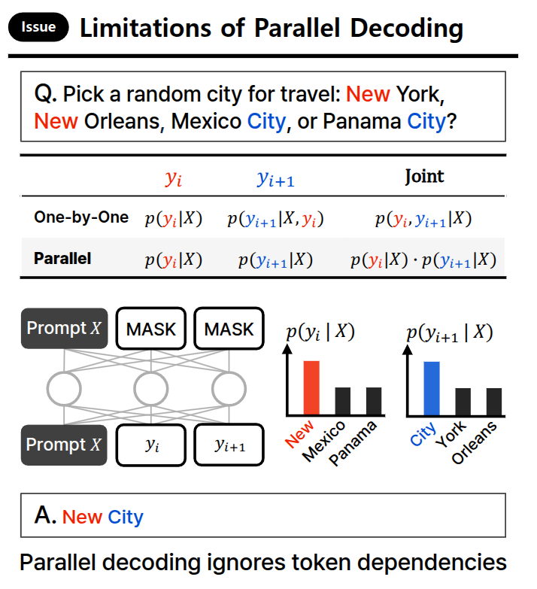
Example 1
E.g. here, sampling y_i and y_{i+1} in parallel will always assign some positive probability to the incorrect answer “New City”
ARMs wouldn’t have this problem: once “New” has been selected as y_i, then y_{i+1} will either be “York” or “Orleans”.

Slide 19
Example 1
E.g. here, sampling y_i and y_{i+1} in parallel will always assign some positive probability to the incorrect answer “New City”
ARMs wouldn’t have this problem: once “New” has been selected as y_i, then y_{i+1} will either be “York” or “Orleans”.

Slide 20
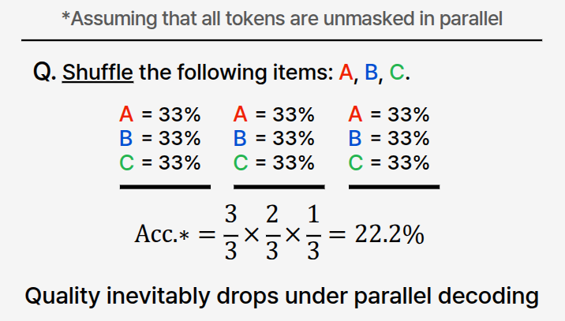
Example 2
Similarly, sampling these three tokens in parallel leaves no way to ensure that the final output will have all three items “A”, “B”, and “C”.

Slide 21
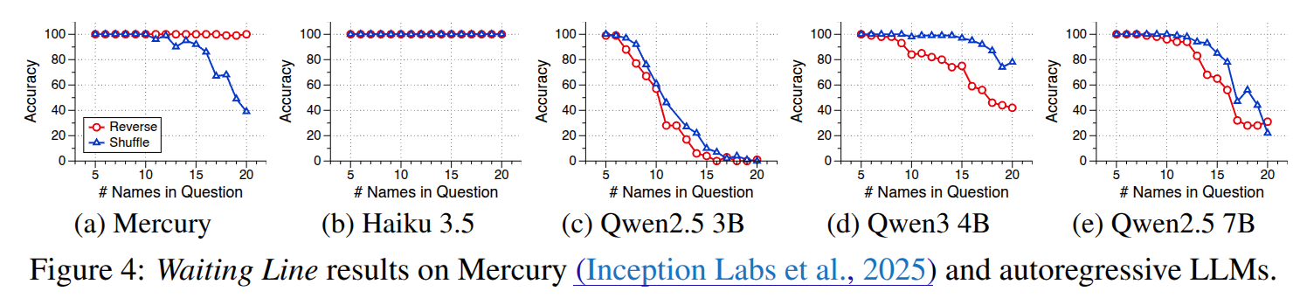
dLLMs vs ARLLMs
This is (sort of) confirmed in real-world models
Mercury (dLLM) maintains accuracy on ‘reverse’ task (as list length increases), but degrades with ‘shuffle’ task
By contrast, ARM accuracy degrades on ‘reverse’ faster than on ‘shuffle’

Slide 22
dLLMs vs ARLLMs
This is (sort of) confirmed in real-world models
Mercury (dLLM) maintains accuracy on ‘reverse’ task (as list length increases), but degrades with ‘shuffle’ task
By contrast, ARM accuracy degrades on ‘reverse’ faster than on ‘shuffle’

Slide 23
dLLMs vs ARLLMs
This is (sort of) confirmed in real-world models
Mercury (dLLM) maintains accuracy on ‘reverse’ task (as list length increases), but degrades with ‘shuffle’ task
By contrast, ARM accuracy degrades on ‘reverse’ faster than on ‘shuffle’

Slide 24
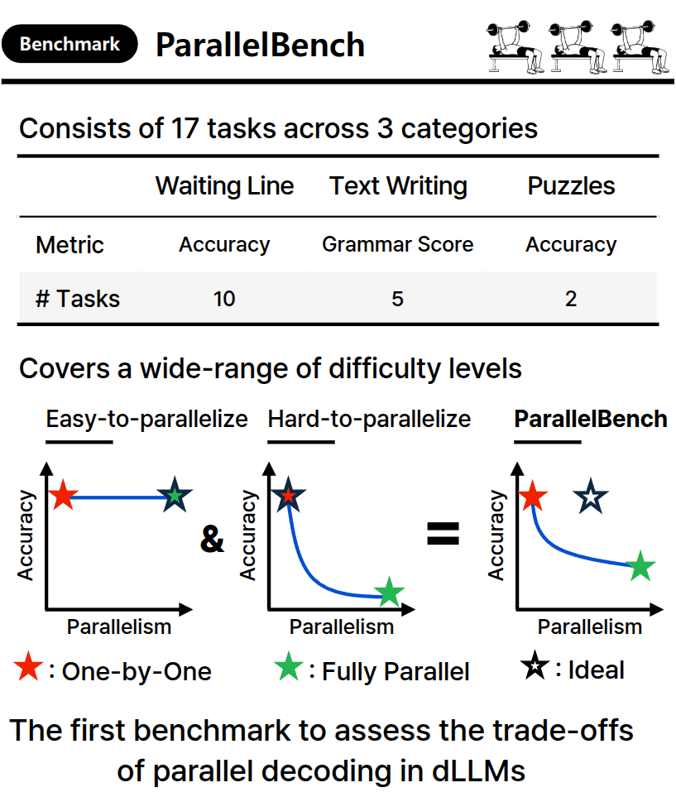
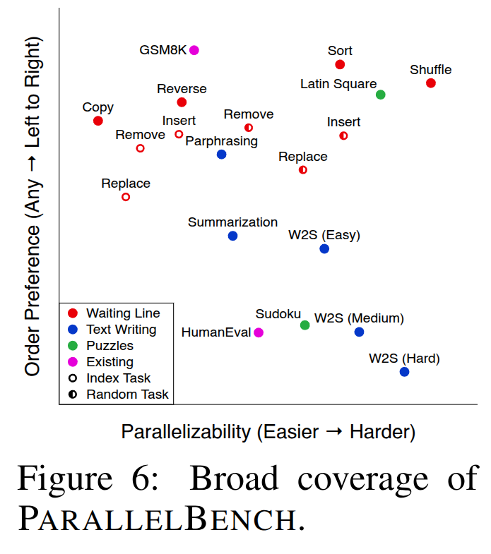
The authors come up with ParallelBench with tasks demanding differing levels of parallelism

Slide 25
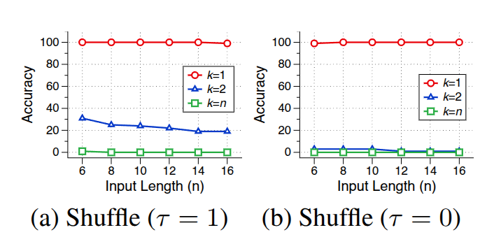
E.g. Shuffle a list of length n
Tau = temperature
K = number of tokens to unmask at each step

Slide 26
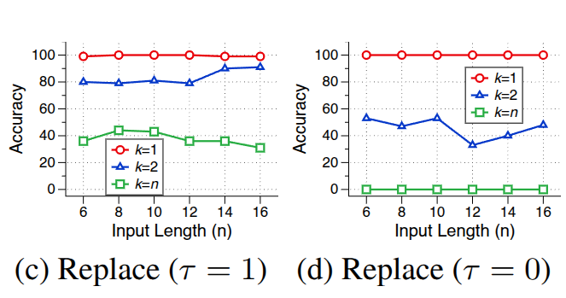
E.g. Replace a specific item in a list of length n
Tau = temperature
K = number of tokens to unmask at each step

Slide 27
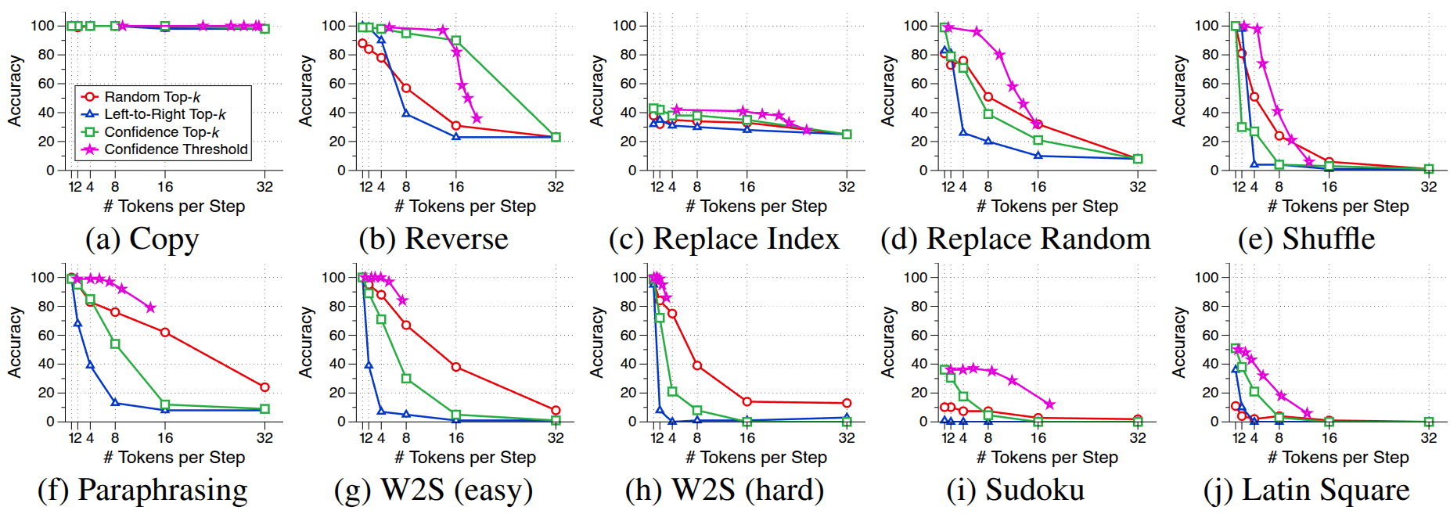
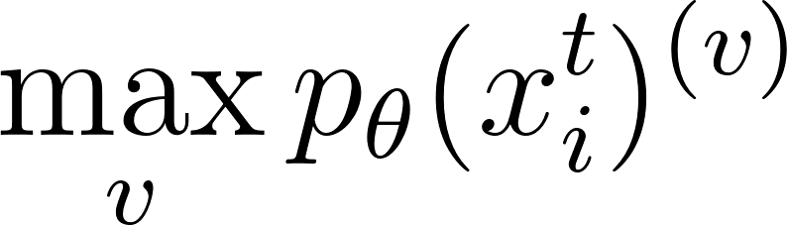
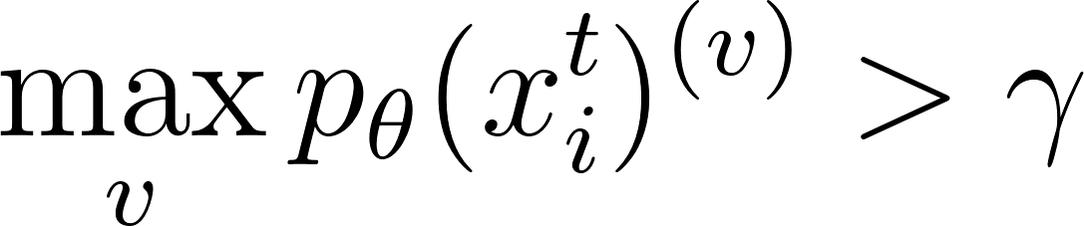
Random top-k: unmask some random k tokens at each step
L2R top-k: unmask the next k tokens
Confidence top-k: unmask the K tokens with highest
Confidence Threshold: unmask all tokens where
In all except (a) and (c), increased parallelism decreases performance

Slide 28
Random top-k: unmask some random k tokens at each step
L2R top-k: unmask the next k tokens
Confidence top-k: unmask the K tokens with highest
Confidence Threshold: unmask all tokens where
In all except (a) and (c), increased parallelism decreases performance

Slide 29
Random top-k: unmask some random k tokens at each step
L2R top-k: unmask the next k tokens
Confidence top-k: unmask the K tokens with highest
Confidence Threshold: unmask all tokens where
In all except (a) and (c), increased parallelism decreases performance

Slide 30
Random top-k: unmask some random k tokens at each step
L2R top-k: unmask the next k tokens
Confidence top-k: unmask the K tokens with highest
Confidence Threshold: unmask all tokens where
In all except (a) and (c), increased parallelism decreases performance

Slide 31
Random top-k: unmask some random k tokens at each step
L2R top-k: unmask the next k tokens
Confidence top-k: unmask the K tokens with highest
Confidence Threshold: unmask all tokens where
In all except (a) and (c), increased parallelism decreases performance

Slide 32
Random top-k: unmask some random k tokens at each step
L2R top-k: unmask the next k tokens
Confidence top-k: unmask the K tokens with highest
Confidence Threshold: unmask all tokens where
In all except (a) and (c), increased parallelism decreases performance

Slide 33
Random top-k: unmask some random k tokens at each step
L2R top-k: unmask the next k tokens
Confidence top-k: unmask the K tokens with highest
Confidence Threshold: unmask all tokens where
In all except (a) and (c), increased parallelism decreases performance

Slide 34
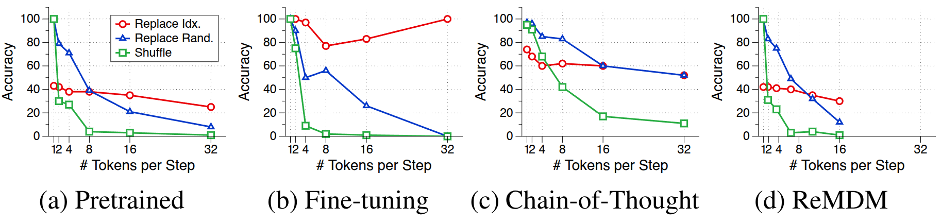
How about using training the underlying model further?
Using (static) random top-k:
Side note: I’m confused by Replace Idx. in (b) getting better with increased parallelism…

Slide 35
Summary of this paper
We want adaptive unmasking strategies:
Exploit parallel decoding when it’s possible
When it’s not possible, fall back on one-token-at-a-time decoding (~any order autoregressive model)
… however, are we sure dLLMs can learn any-order AR generation effectively?

Slide 36
Summary of this paper
We want adaptive unmasking strategies:
Exploit parallel decoding when it’s possible
When it’s not possible, fall back on one-token-at-a-time decoding (~any order autoregressive model)
… however, are we sure dLLMs can learn any-order AR generation effectively?

Slide 37
Summary of this paper
We want adaptive unmasking strategies:
Exploit parallel decoding when it’s possible
When it’s not possible, fall back on one-token-at-a-time decoding (~any order autoregressive model)
… however, are we sure dLLMs can learn any-order AR generation effectively?

Slide 38
Summary of this paper
We want adaptive unmasking strategies:
Exploit parallel decoding when it’s possible
When it’s not possible, fall back on one-token-at-a-time decoding (~any order autoregressive model)
… however, are we sure dLLMs can learn any-order AR generation effectively?

Slide 39
Summary of this paper
We want adaptive unmasking strategies:
Exploit parallel decoding when it’s possible
When it’s not possible, fall back on one-token-at-a-time decoding (~any order autoregressive model)
… however, are we sure dLLMs can learn any-order AR generation effectively?

Slide 40
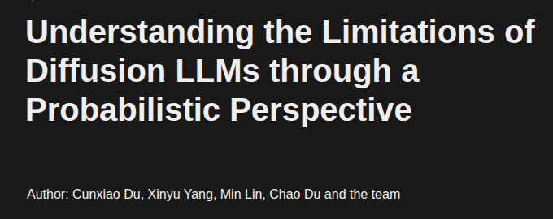
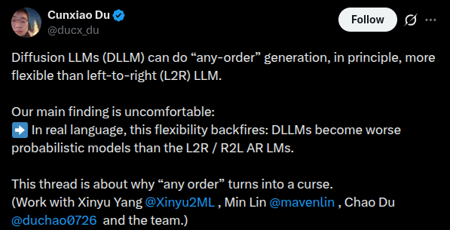

Slide 41
Limitations of the any-order generation view of dLLMs
From this point on, let’s forget about parallel decoding and assume our dLLM only samples one token at a time
This isn’t a reasonable assumption to make to represent all dLLM behaviour
But the ability to accurately decode one-token-at-a-time is a useful behaviour we want our dLLM to have
Parallelism is just the ‘icing on the cake’

Slide 42
Limitations of the any-order generation view of dLLMs
From this point on, let’s forget about parallel decoding and assume our dLLM only samples one token at a time
This isn’t a reasonable assumption to make to represent all dLLM behaviour
But the ability to accurately decode one-token-at-a-time is a useful behaviour we want our dLLM to have
Parallelism is just the ‘icing on the cake’

Slide 43
Limitations of the any-order generation view of dLLMs
From this point on, let’s forget about parallel decoding and assume our dLLM only samples one token at a time
This isn’t a reasonable assumption to make to represent all dLLM behaviour
But the ability to accurately decode one-token-at-a-time is a useful behaviour we want our dLLM to have
Parallelism is just the ‘icing on the cake’

Slide 44
Limitations of the any-order generation view of dLLMs
From this point on, let’s forget about parallel decoding and assume our dLLM only samples one token at a time
This isn’t a reasonable assumption to make to represent all dLLM behaviour
But the ability to accurately decode one-token-at-a-time is a useful behaviour we want our dLLM to have
Parallelism is just the ‘icing on the cake’

Slide 45
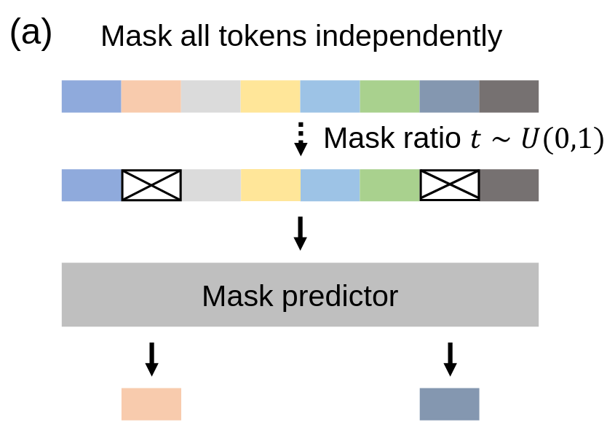
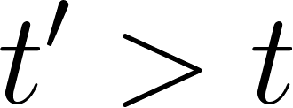
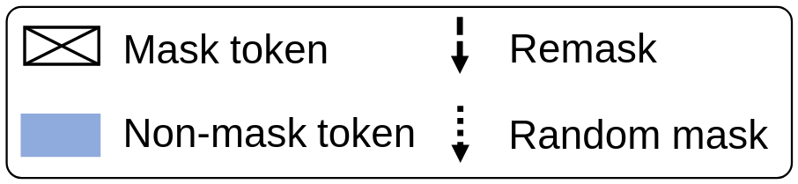
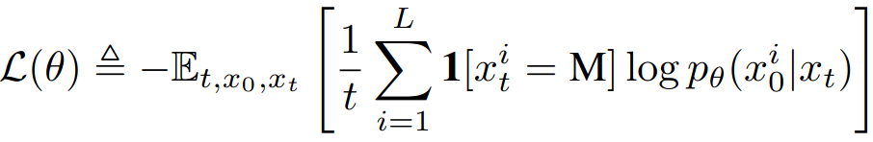
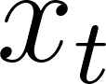
Recap: Training a dLLM
forward process: gradually mask tokens (independently) until fully masked at :
At time each token is masked with prob .
(Once a token is masked it stays masked for .)
reverse process: predict masked tokens as moves from 0 to 1:
Use a cross-entropy loss only on the masked tokens:
where , and is sampled from the forward process.

Slide 46
Recap: Training a dLLM
forward process: gradually mask tokens (independently) until fully masked at :
At time each token is masked with prob .
(Once a token is masked it stays masked for .)
reverse process: predict masked tokens as moves from 0 to 1:
Use a cross-entropy loss only on the masked tokens:
where , and is sampled from the forward process.

Slide 47
Recap: Training a dLLM
forward process: gradually mask tokens (independently) until fully masked at :
At time each token is masked with prob .
(Once a token is masked it stays masked for .)
reverse process: predict masked tokens as moves from 0 to 1:
Use a cross-entropy loss only on the masked tokens:
where , and is sampled from the forward process.

Slide 48
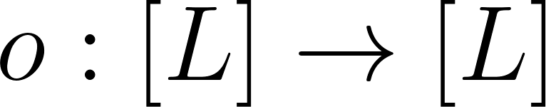
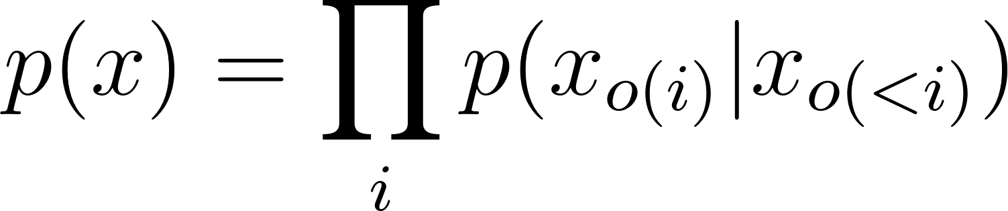
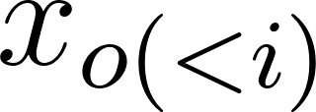
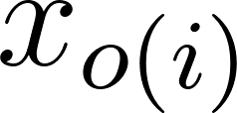
Any-Order Factorisation
With any permutation over token indices, we can factorise our dLLM into an autoregressive formulation
Where
are the visible/unmasked tokens
is the next masked token to be predicted

Slide 49
Any-Order Factorisation
With any permutation over token indices, we can factorise our dLLM into an autoregressive formulation
Where
are the visible/unmasked tokens
is the next masked token to be predicted

Slide 50
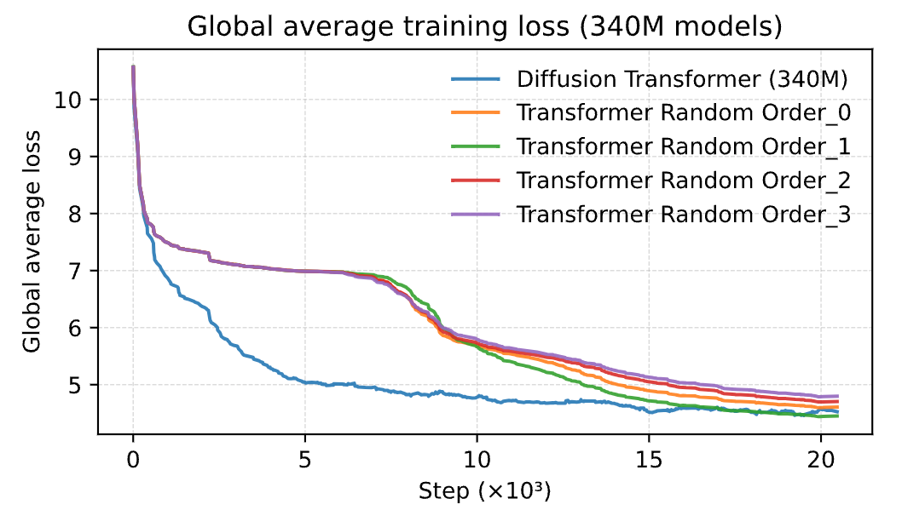
Random-order Transformers work about as well as a dLLM (at the end of training)

Slide 51
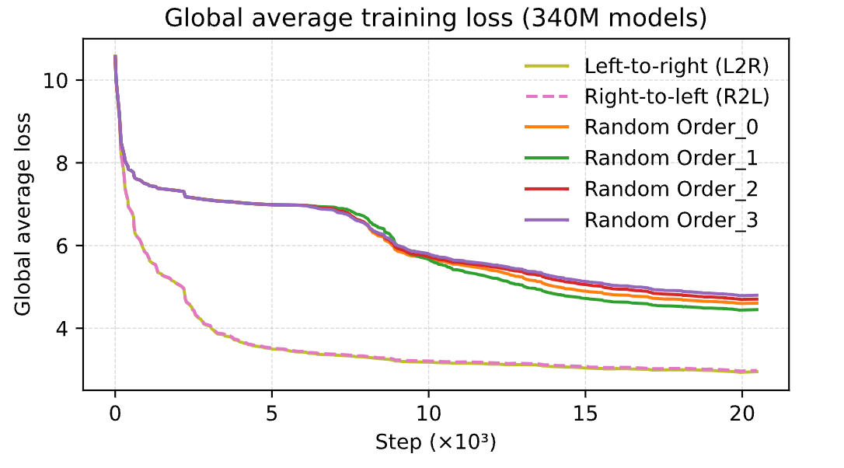
But is ‘random ordered’ actually desirable?
(perhaps unsurprisingly) no.
L2R or R2L are easier to model
Since a dLLM optimises all orders uniformly they:
Don’t naturally concentrate capacity on more favourable orderings (L2R, R2L)
Obtain a significantly looser approximation to the underlying data distribution

Slide 52
But is ‘random ordered’ actually desirable?
(perhaps unsurprisingly) no.
L2R or R2L are easier to model
Since a dLLM optimises all orders uniformly they:
Don’t naturally concentrate capacity on more favourable orderings (L2R, R2L)
Obtain a significantly looser approximation to the underlying data distribution

Slide 53
But is ‘random ordered’ actually desirable?
(perhaps unsurprisingly) no.
L2R or R2L are easier to model
Since a dLLM optimises all orders uniformly they:
Don’t naturally concentrate capacity on more favourable orderings (L2R, R2L)
Obtain a significantly looser approximation to the underlying data distribution

Slide 54
But is ‘random ordered’ actually desirable?
(perhaps unsurprisingly) no.
L2R or R2L are easier to model
Since a dLLM optimises all orders uniformly they:
Don’t naturally concentrate capacity on more favourable orderings (L2R, R2L)
Obtain a significantly looser approximation to the underlying data distribution

Slide 55
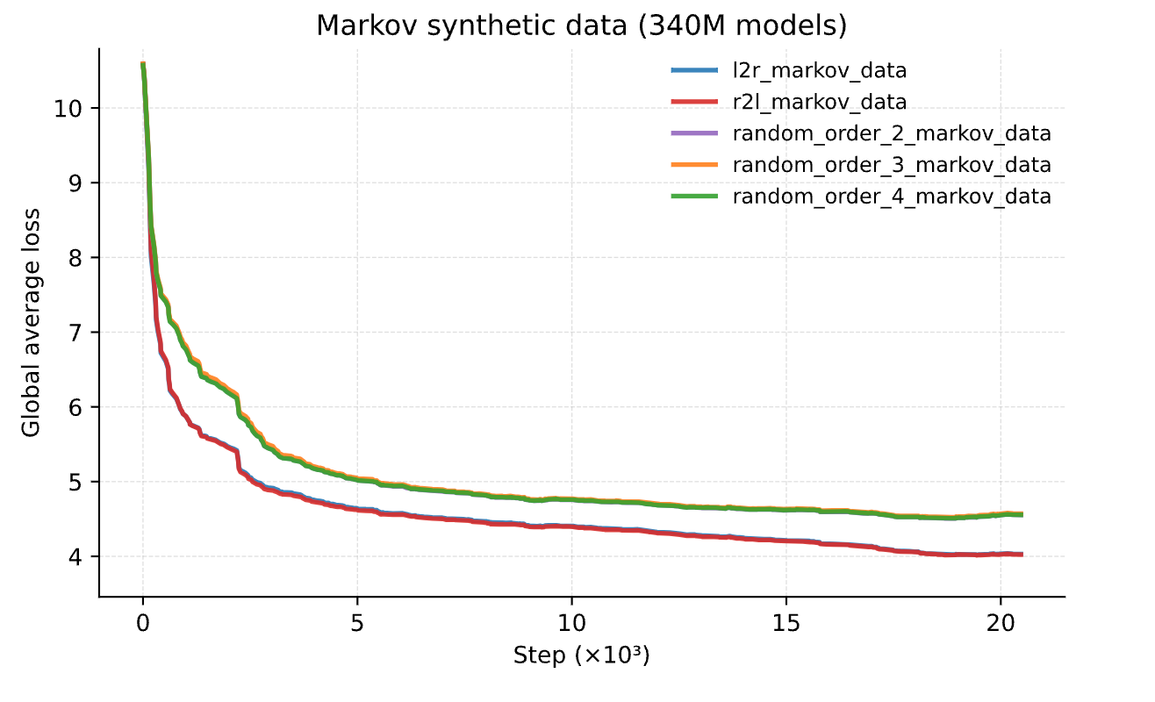
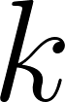
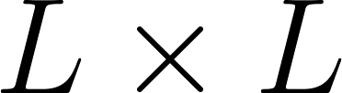
Why is L2R or R2L better than a random order?
“Most data in natural language approximately satisfies a Markov assumption”
So random ordering/permutations increase the required Markov neighbourhood size
Although full attention could solve this, it’s still harder to learn the optimal solution for all permutations at once

Slide 56
Why is L2R or R2L better than a random order?
“Most data in natural language approximately satisfies a Markov assumption”
So random ordering/permutations increase the required Markov neighbourhood size
Although full attention could solve this, it’s still harder to learn the optimal solution for all permutations at once

Slide 57
Why is L2R or R2L better than a random order?
“Most data in natural language approximately satisfies a Markov assumption”
So random ordering/permutations increase the required Markov neighbourhood size
Although full attention could solve this, it’s still harder to learn the optimal solution for all permutations at once

Slide 58
Why is L2R or R2L better than a random order?
“Most data in natural language approximately satisfies a Markov assumption”
So random ordering/permutations increase the required Markov neighbourhood size
Although full attention could solve this, it’s still harder to learn the optimal solution for all permutations at once

Slide 59
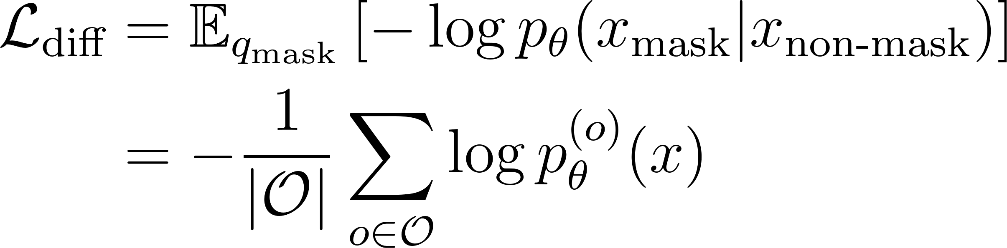
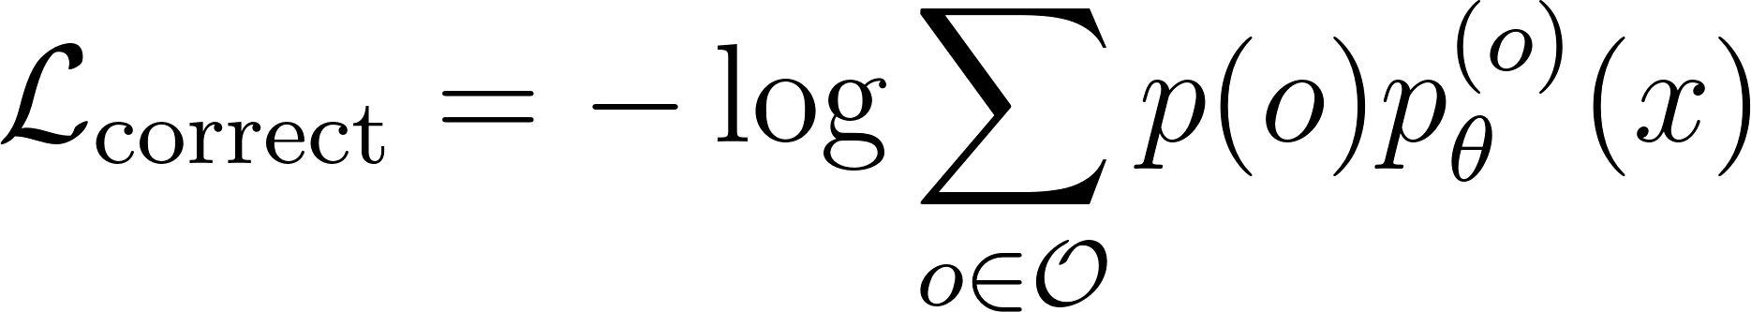
Can we fix the ELBO?
dLLMs optimise the loss with a sum-log objective
But maybe instead we should optimise a log-sum objective
This will get dominated by the best generation order, rather than requiring all orders to generate well

Slide 60
Can we fix the ELBO?
dLLMs optimise the loss with a sum-log objective
But maybe instead we should optimise a log-sum objective
This will get dominated by the best generation order, rather than requiring all orders to generate well

Slide 61
Can we fix the ELBO?
dLLMs optimise the loss with a sum-log objective
But maybe instead we should optimise a log-sum objective
This will get dominated by the best generation order, rather than requiring all orders to generate well

Slide 62
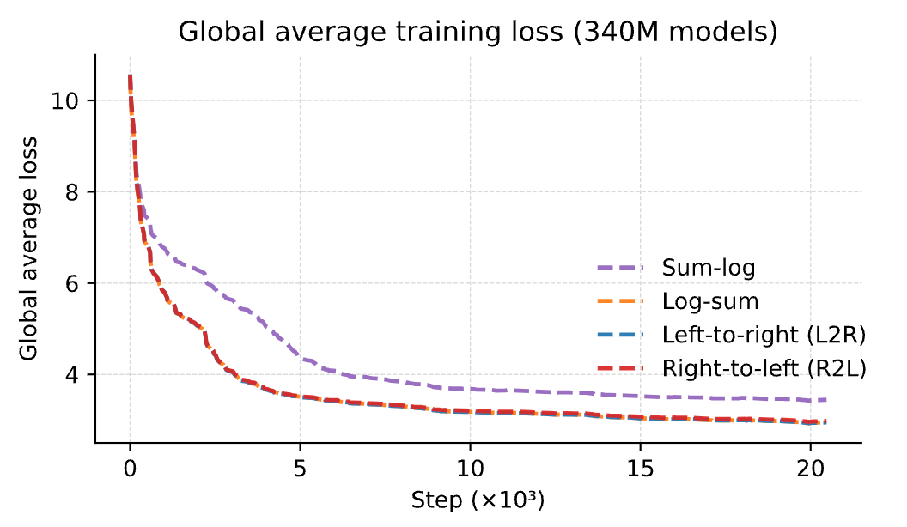
With four permutations we see that the log-sum loss does recover the optimal loss of L2R & R2L (albeit with 4x the computation)

Slide 63
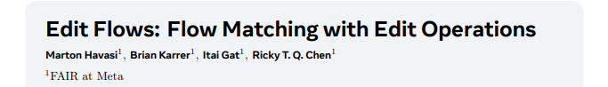
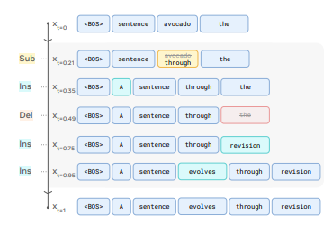
Conclusion
I don’t think this is a death knell for dLLMs
Even if L2R gives us a better loss than some random permutation, that doesn’t mean L2R is the optimal ordering
Especially for a lot of the ParallelBench tasks
Anyway, there’s a tradeoff between performance and speed
Plus, dLLMs are basically only a year old at this point
There are lots of fancy things we’ve yet to try
Edit-diffusion models seem promising imo

Slide 64
Conclusion
I don’t think this is a death knell for dLLMs
Even if L2R gives us a better loss than some random permutation, that doesn’t mean L2R is the optimal ordering
Especially for a lot of the ParallelBench tasks
Anyway, there’s a tradeoff between performance and speed
Plus, dLLMs are basically only a year old at this point
There are lots of fancy things we’ve yet to try
Edit-diffusion models seem promising imo

Slide 65
Conclusion
I don’t think this is a death knell for dLLMs
Even if L2R gives us a better loss than some random permutation, that doesn’t mean L2R is the optimal ordering
Especially for a lot of the ParallelBench tasks
Anyway, there’s a tradeoff between performance and speed
Plus, dLLMs are basically only a year old at this point
There are lots of fancy things we’ve yet to try
Edit-diffusion models seem promising imo

Slide 66
Conclusion
I don’t think this is a death knell for dLLMs
Even if L2R gives us a better loss than some random permutation, that doesn’t mean L2R is the optimal ordering
Especially for a lot of the ParallelBench tasks
Anyway, there’s a tradeoff between performance and speed
Plus, dLLMs are basically only a year old at this point
There are lots of fancy things we’ve yet to try
Edit-diffusion models seem promising imo

Slide 67
Conclusion
I don’t think this is a death knell for dLLMs
Even if L2R gives us a better loss than some random permutation, that doesn’t mean L2R is the optimal ordering
Especially for a lot of the ParallelBench tasks
Anyway, there’s a tradeoff between performance and speed
Plus, dLLMs are basically only a year old at this point
There are lots of fancy things we’ve yet to try
Edit-diffusion models seem promising imo

Slide 68
Conclusion
I don’t think this is a death knell for dLLMs
Even if L2R gives us a better loss than some random permutation, that doesn’t mean L2R is the optimal ordering
Especially for a lot of the ParallelBench tasks
Anyway, there’s a tradeoff between performance and speed
Plus, dLLMs are basically only a year old at this point
There are lots of fancy things we’ve yet to try
Edit-diffusion models seem promising imo

Slide 69
Conclusion
I don’t think this is a death knell for dLLMs
Even if L2R gives us a better loss than some random permutation, that doesn’t mean L2R is the optimal ordering
Especially for a lot of the ParallelBench tasks
Anyway, there’s a tradeoff between performance and speed
Plus, dLLMs are basically only a year old at this point
There are lots of fancy things we’ve yet to try
Edit-diffusion models seem promising imo

Slide 70
Conclusion
I don’t think this is a death knell for dLLMs
Even if L2R gives us a better loss than some random permutation, that doesn’t mean L2R is the optimal ordering
Especially for a lot of the ParallelBench tasks
Anyway, there’s a tradeoff between performance and speed
Plus, dLLMs are basically only a year old at this point
There are lots of fancy things we’ve yet to try
Edit-diffusion models seem promising imo

